Slide 1

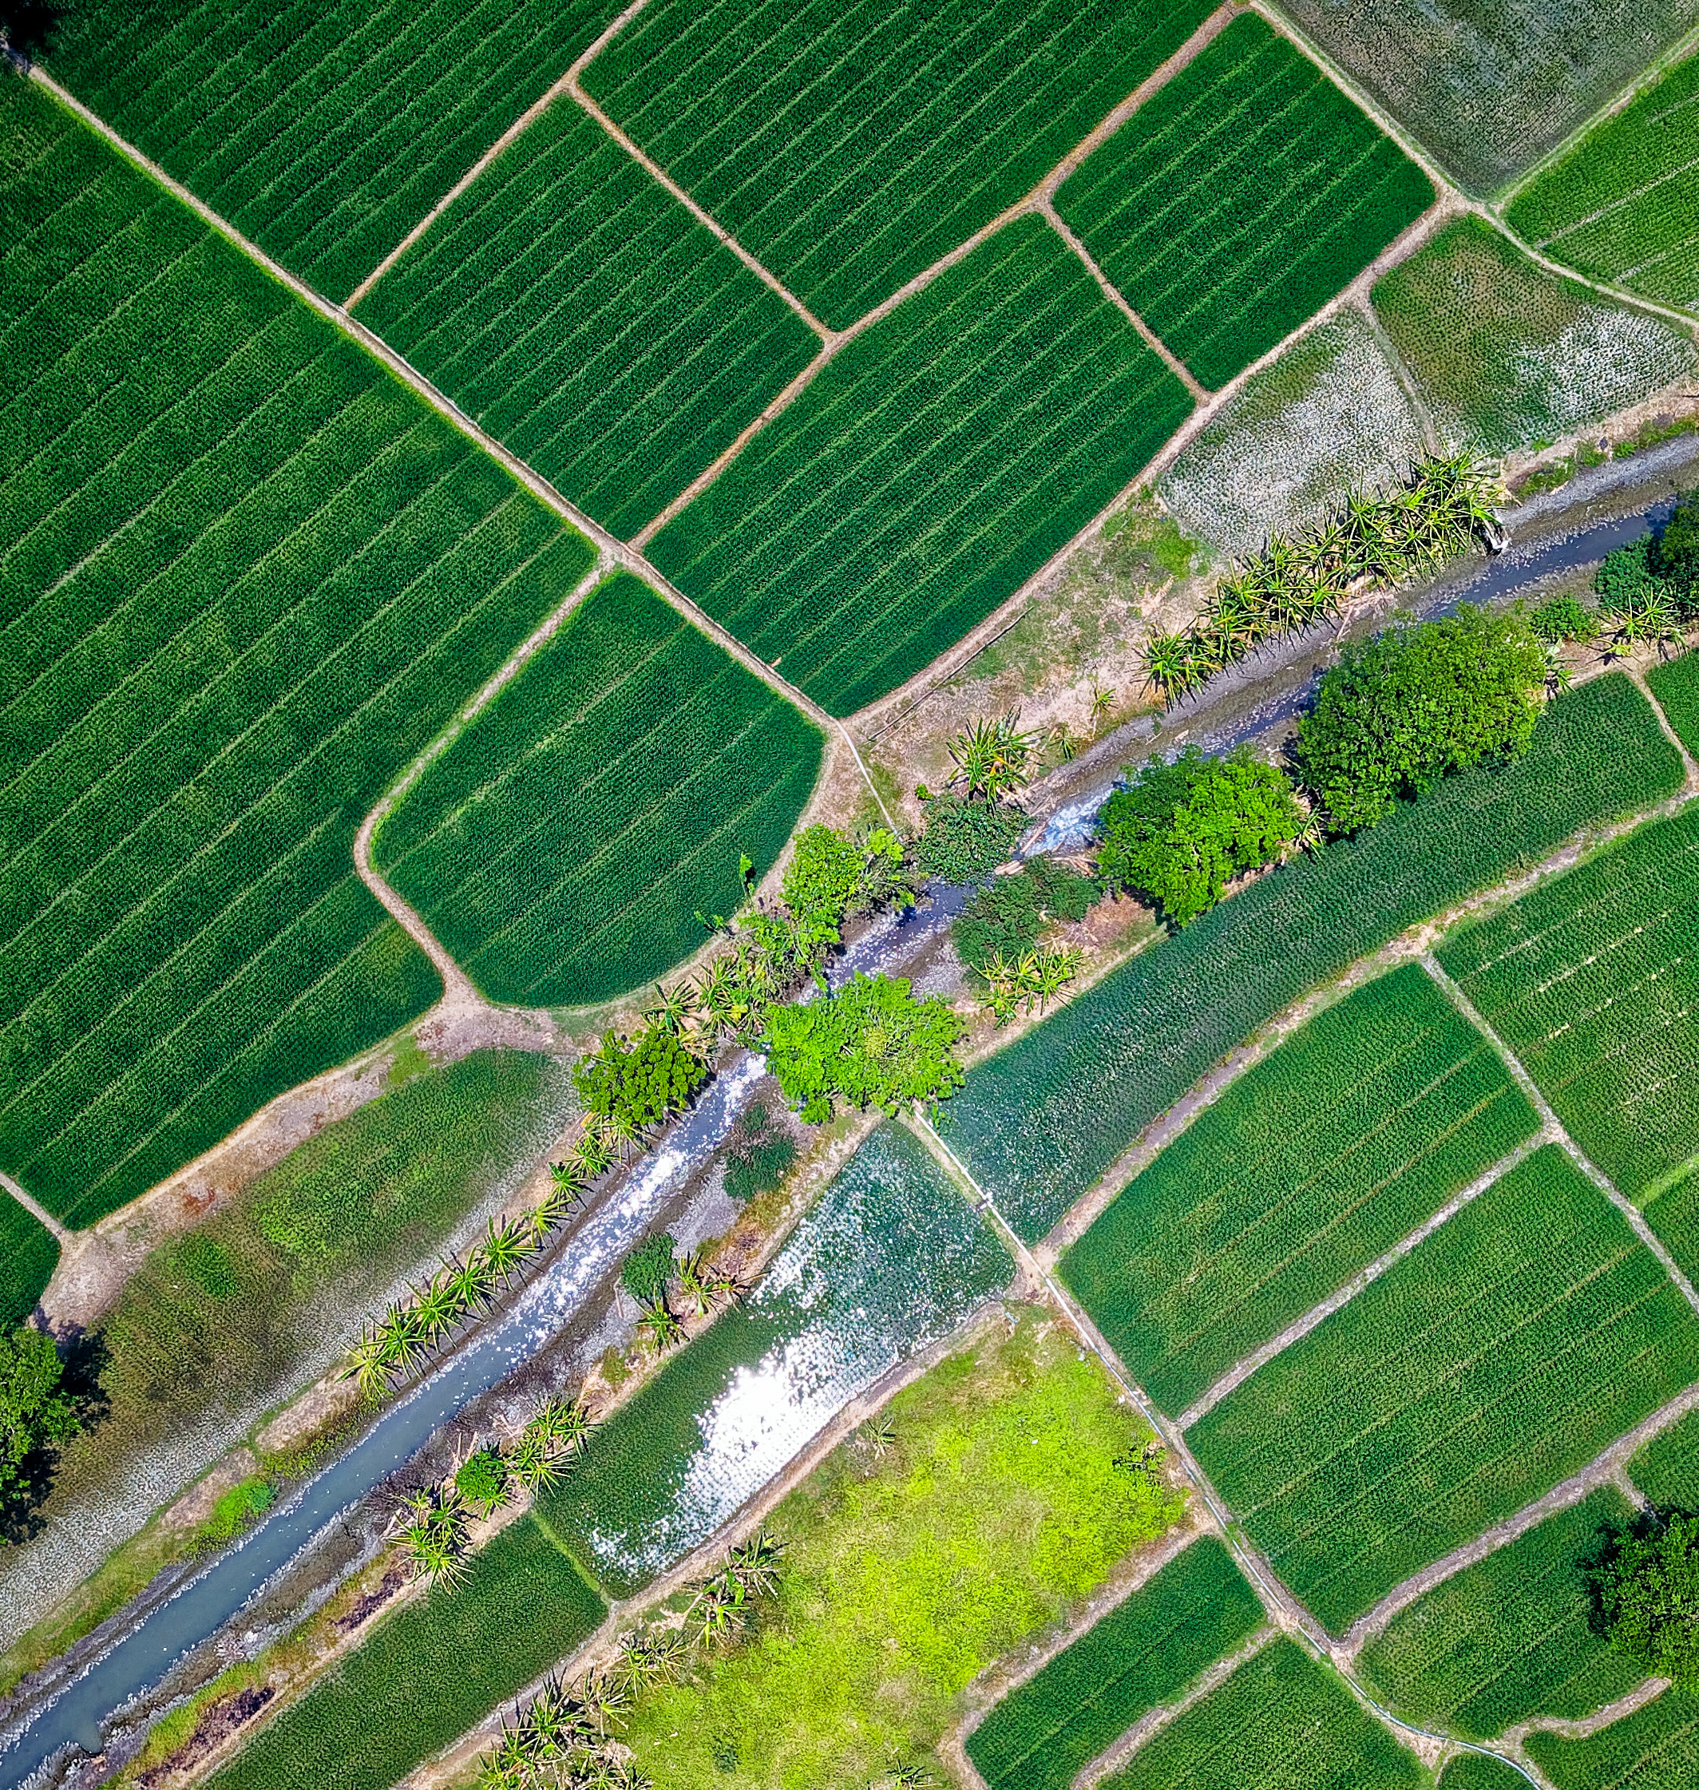
Malawi Forecasts Strategic Climate Solution
Enhancing Resilience and Decision-Making
Presented by George M. Rading

Slide 2

Addressing Climate Vulnerability
Malawi’s agricultural economy and food security are at risk due to erratic rainfall, rising temperatures, and prolonged droughts.
Challenge
Stakeholders lack forward-looking insights, leading to suboptimal decisions, crop failures, and resource inefficiencies.
Objective
Transition to proactive, evidence-based planning.

Slide 3

A Transformative Early Warning System
Malawi Forecasts delivers 5-year climate predictions tailored to agricultural needs.
Provides actionable insights to guide strategic decision-making and enhance resilience.

Slide 4

Harnessing Data for the Future
Analyzes historical weather patterns to forecast trends over the next 5 years.
Delivers reliable, high-confidence predictions to support informed choices.

Slide 5

Comprehensive Capabilities
Generate region-specific or national climate forecasts.
Offer evidence-based crop recommendations and cautions with clear rationale.
Present data through intuitive, high-impact visualizations.
Enable data export for strategic reporting and analysis.

Slide 6

User-Centric Digital Platform
Home & Navigation: Intuitive homepage with About and Help options for guidance.
Forecast Access: Select national or regional forecasts (e.g., Nkhotakota) with ease.
Dashboard Insights: Displays rainfall, NDVI(Vegetation health ), temperature averages, and crop recommendations with reasons.
Export & Flexibility: Downloadable PDFs/CSV files; option to forecast again or return home.

Slide 7

Commitment to Trust and Precision
Incorporates rigorous validation against historical outcomes.
Transparent rationale for top and least suitable crops.
Ensures dependable insights through continuous performance assessment.

Slide 8

User-Centric Digital Platform
Farmers & Cooperatives: Optimize planting for higher yields.
NGOs & Aid Organizations: Direct resources effectively.
Government & Policymakers: Shape robust food security policies.
Researchers: Leverage data for advanced studies.

Slide 9
Path to Deployment
Supported setup and integration with your data.
Initiate a pilot program in a selected district for validation and refinement.

Slide 10
Unmatched Value Proposition
Transforms climate data into actionable agricultural strategies.
Enables proactive planning to mitigate risks.
Delivers proven impact on food security and resilience.

Slide 11

Questions & Discussion
Open forum for inquiries

